Slide 1


Presentation ReactJS
Present: Nguyễn Văn Quốc – DG1
Mentor: Lê Đại Trọng

Slide 2
Agenda
What is ReactJS ?
Why ReactJS?
Features of ReactJS ?
Component, Props, State?
What is Java Springboot?
What is Springboot JPA?
Connecting with MySQL?
What is Restful API?
Demo

Slide 3
What is ReatJS?

Slide 4
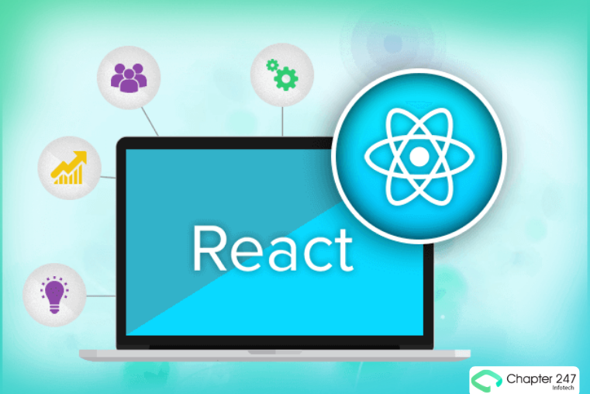
ReactJS
React.js is an open-source JavaScript library that is used for building user interfaces specifically for single-page applications.
It’s used for handling the view layer for web and mobile apps. React also allows us to create reusable UI components.
React was first created by Jordan Walke, a software engineer working for Facebook.

Slide 5
Why ReactJS ?

Slide 6
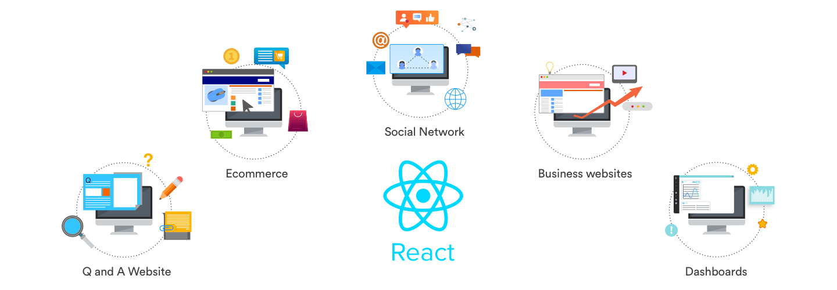
Why
Easy creation of dynamic web applications
Performance enhancements
Reusable components
Unidirectional data flow
Can be used for mobile apps
Dedicated tools for easy debugging

Slide 7
Features of ReactJS

Slide 8
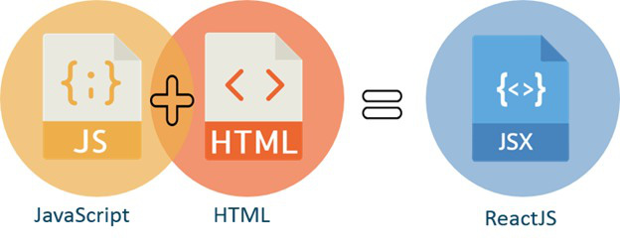
JSX – JavaScrip Syntax Extension
JSX is a syntax extension to JavaScript. It is used with React to describe what the User interface should look like.
By using JSX, you can write HTML structures in the same file that contains javaScript code.
JSX helps in making the code easier to understand and debug as it avoids usage of JS DOM structutes which are rather complex.

Slide 9
Virtual DOM
DOM is an abbreviation for Document Object Model, which is a standard defined by the W3C for accessing and manipulating HTML or XML code using scripting languages.
The virtual DOM is a lightweight copy of the real DOM
You can imagine, in DOM with div and p tags inside, ReactJs uses Virtual DOM by creating React.div and React.p objects and when interacting, we will interact through those objects one at a time quickly without having to touch the DOM or its DOM API.

Slide 10
Component, Props, State

Slide 11
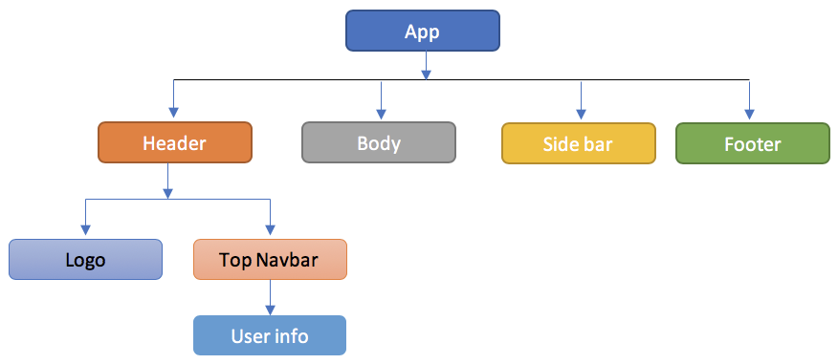
Components
Components are the building blocks of any React application, and an application usually consists of many components
A component is essentially a piece of the User interface.
It splits the User interface into independent, reusable pieces that can be processed separately.

Slide 12
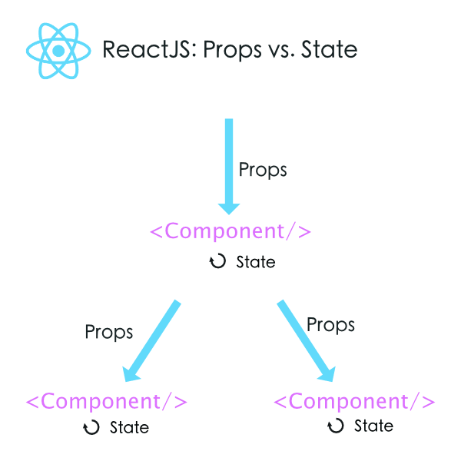
State
State is an object that can be used to hold data or information about components
This data influences the output of a component.
State exists only in the scope of its containing components.

Slide 13
Props
props stands for property, used to store data
Props allows us to communicate between components by passing parameters back and forth between components.

Slide 14
What is Java Springboot?

Slide 15

Java Springboot
Spring Boot is a project developed by JAV (java language) in the Spring framework ecosystem. It helps us programmers simplify the process of programming an application with Spring, focusing only on developing business for the application.

Slide 16
What is Springboot JPA?

Slide 17
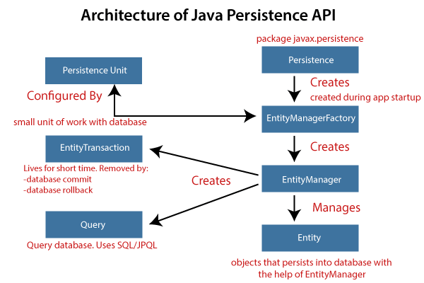
Java Springboot JPA
Spring Boot JPA is a Java specification for managing relational data in Java applications. It allows us to access and store data between Java objects/classes and relational databases.

Slide 18
Connecting with MySQL?

Slide 19
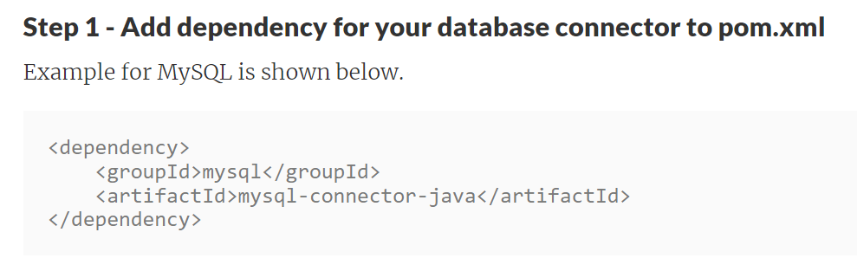
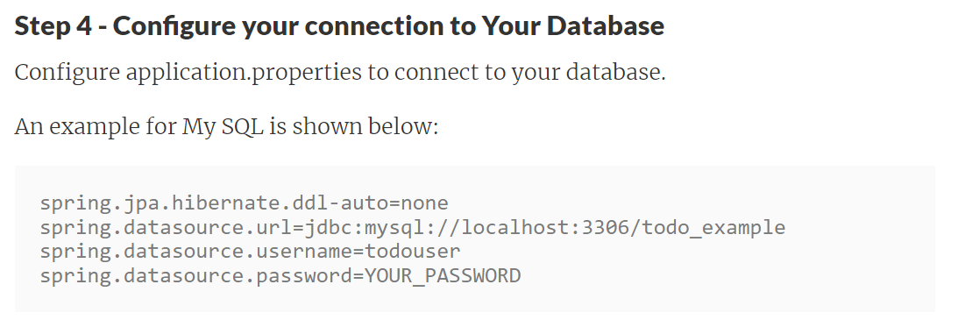
Connecting MySQL
Declare only 1 more spring-data dependency(pom.xml) and configuration properties to the application.properties file.

Slide 20
What is Restful API?

Slide 21
Restful API
API (Application Programming Interface) is a set of rules and mechanisms by which an application or component interacts with another application or component.
REST (REpresentational State Transfer) is a form of data structure transformation, an architectural style for writing API.
RESTful API is a standard used in the design of APIs for web applications to manage resources. RESTful is one of the most commonly used API design styles today to let different applications (web, mobile…) communicate with each other.

Slide 22
DEMO

Slide 23

23

Slide 24
Thank You
for
Watching and Listening

